Slide 1

ORPHANAGE MANAGEMENT SYSTEM
GROUP – 31
GROUP MEMBERS:
K.BHARATH REDDY - S20190010080(LEADER)
K.ROKESH REDDY - S20190010098
M.HARSSHATH - S20190010116
S.PRABHU TEJA - S20190010155
P.GOVARDHAN NAIK - S20190010135

Slide 2
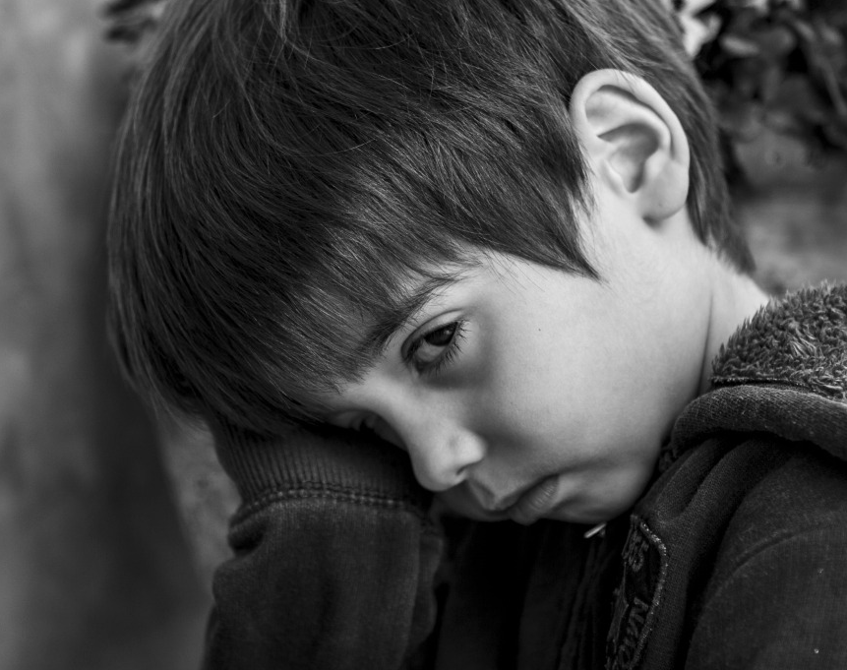
ORPHANAGE MANAGEMENT SYSTEM
SMILE FOUNDATION

Slide 3

CAUSE OF THE PROJECT
* Orphans are the children who lost their parents or abandoned from the family, they face lot of challenges in the society.
* Orphanages helps them by providing shelter, proper food and education but all orphanages can't fulfill all the requirements of the children.
* The main reason for children poor nutrition is because Orphanages lack with proper funding's and support.
* Orphans are disturbed mentally due to absence of their family members, this may affect their overall development.
* Orphanages can't afford huge amounts on medical and higher education of orphans.

Slide 4
AIM OF THE PROJECT
Our team decided to build a web application which can help the orphanages and support the children.
Orphanage management system will help to improve the performance of current situation and overcome the problems that rise nowadays.

Slide 5
FEATURES
Distribution of surplus food
Events
Donation
Sponsoring and Adaption of the Orphans
Promoting orphan handcraft products
Volunteer Registration

Slide 6
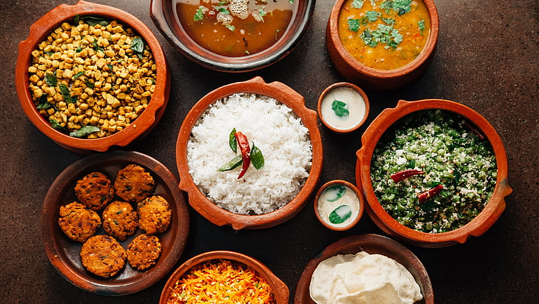
Distributing of Surplus Food
We aim to distribute surplus food to orphanage .if you have excess food from an event, party, wedding etc..
The event organizers can register on our website and they can contact through our helpline number for any queries.
Our team volunteers will collect the excess food from them and distribute it to the orphans in the orphanages.

Slide 7
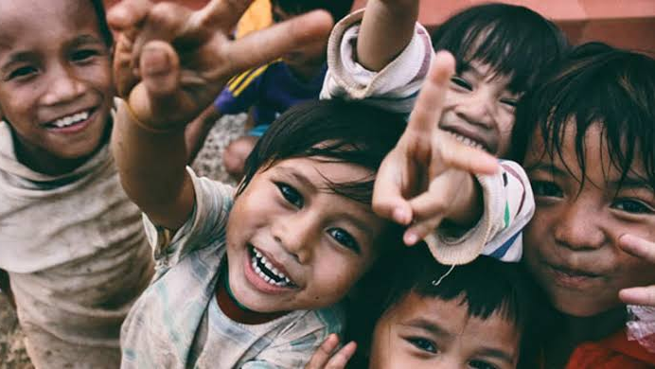
EVENTS
It is good to celebrate the birthdays, anniversaries, festivals and such important days in orphanages .It gives the orphans a chance to enjoy and cherish themselves .
So many people have no idea how to contact orphanages to celebrate their events.
Many people have interest to celebrate their important days in the orphanages.
Those who are willing to celebrate their important days in the orphanages with the children, can register on our website and our team will schedule the time slot to celebrate their events.

Slide 8

DONATION
Our website provides a very easy and secure payments gateway to the donors.
Transparency is very important now a days, our website displays the source of donations and how we use it.
A detailed financial progress report with complete information of expenditure is provided on our website from time to time.
People who are willing to donate old things like books,clothes,toys,blankets,..etc. can easily donate by just filling up a form on our website.

Slide 9

SPONSORING & ADOPTION
Each and every children profiles are displayed on our website which makes easy access.
The individuals who are willing to take responsibilities(complete monthly expenditure) of an orphan can easily register and sponsor through our website.
Financial support can be given to the bright children who are willing to pursue higher education.
Our website provides basic guidelines and legal procedure for adoption of orphans.

Slide 10

VOLUNTEERING
The volunteer opportunity is full of life is often viewed as life changing experience.
Citizens who are willing to serve orphans whole heartedly with love and care can easily register through our website and can serve the orphan home.
Volunteers are deployed in different works like collecting things like books,clothes,toys. etc. from donors, searching for shelter less children and servicing in the orphanage homes.

Slide 11

Front-end languages: HTML, CSS, JavaScript(MERN Stack)
Front-end frameworks: React.js
Back-end: Python, JavaScript
Back-end frameworks: Django
Database: MySQL

Slide 12

WORK ALLOTMENT
ALL SOFTWARE COMPONENTS OF THE PROJECT ARE EQUALLY ALLOTED TO THE RESPECTIVE MEMBERS OF THE GROUP:
DISTRIBUTION OF SURPLUS FOOD - BHARATH, HARSSHATH
EVENTS - ROKESH,PRABHU
DONATION - GOVARDHAN,ROKESH
SPONSORING & ADOPTION - HARSSHATH,PRABHU
VOLUNTEERING & PROMOTIONS - BHARATH,GOVARDHAN

Slide 13

TIMELINE
Feb 10th ----> Homepage, contact page, volunteer registration.
Feb 28th ----> frontend part of home page i.e. User and orphanage people interface.
Mar 7th ----> Frontend part : Register forms for Distribution of Surplus food ,Donation and signup pages, Profile Management of Sponsoring & Adoption, Volunteering and Donation, form filling of events for celebrating in Orphanages , form filling for donating old things.
Mar 15th ----> Frontend part :Sponsoring and Adoption i.e. guidelines to adapt a child, and promotions i.e. gallery showcasing the artwork of orphans. Volunteering i.e. display alert message of work to volunteer and remaining Frontend part of features Donation and Events.
Mar 30th ----> backend part of features Distribution of Surplus food, Events and Donations .
Apr 15th ----> backend part of features Sponsoring and Adoption ,Volunteering.

Slide 14
GITHUB REPOSITORY
https://github.com/rokesh27/WAD-PROJECT

Slide 15
THANK YOU

